Slide 1
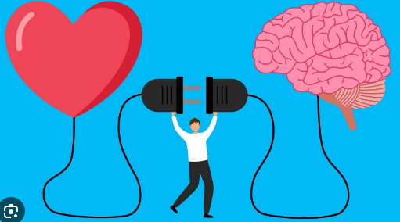
Emotional Intelligence

Slide 2
What is Emotional Intelligence?
Emotional Intelligence (EI) is the ability to recognize, understand, manage, and influence emotions in oneself and others. It plays a key role in personal and professional success.

Slide 3
Emotional intelligence (EI), or emotional quotient (EQ), is the ability to perceive, understand, manage, and use one's own emotions and those of others. It is a skill set that enables effective communication, strong relationships, and better decision-making, encompassing components like self-awareness, self-management, social awareness (empathy), and social skills. Unlike cognitive intelligence (IQ), EI is a learnable skill that can be developed and improved to lead a more fulfilling life and succeed in both personal and professional spheres.

Slide 4
Key Components of Emotional Intelligence
Self-Awareness:
Recognizing and understanding your own emotions, strengths, weaknesses, and how they influence your thoughts and behavior.
Self-Management:
The ability to effectively manage your emotions, regulate your responses, and channel positive emotions to achieve goals.
Social Awareness (Empathy):
Understanding the emotions, needs, and perspectives of other people.
Social Skills (Relationship Management):
Using your awareness of your own and others' emotions to build effective and constructive relationships.

Slide 5
Why Emotional Intelligence Is Important
Better Relationships:
High EI leads to improved communication, understanding, and connection with others.
Effective Leadership:
Leaders with strong EI can empathize with their teams, manage conflict, and inspire effective collaboration.
Enhanced Decision-Making:
By understanding emotions, you can make clearer decisions and solve problems more effectively.
Personal Well-being:
Managing emotions and understanding social cues contributes to a more fulfilling and balanced life

Slide 6
Importance of Emotional Intelligence
• Enhances self-awareness and self-control
• Improves communication and relationships
• Helps manage stress and conflict
• Boosts leadership and teamwork skills
• Supports personal and professional growth

Slide 7
Key elements of emotional intelligence (EI),
The five key elements of emotional intelligence (EI), according to psychologist Daniel Goleman, are Self-Awareness, Self-Regulation, Motivation, Empathy, and Social Skills. These components help individuals understand and manage their own emotions, recognize and respond to the emotions of others, and build strong, effective relationships.

Slide 8
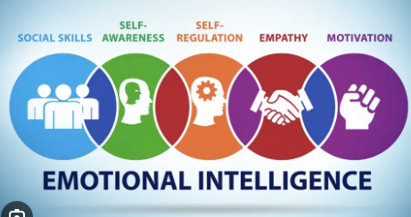

Slide 9
🔑 Components of Emotional Intelligence
• Self-Awareness – Recognizing your emotions
• Self-Regulation – Managing your emotions
• Motivation – Staying focused and positive
• Empathy – Understanding others’ feelings
• Social Skills – Building healthy relationships

Slide 10
Here's a closer look at each element:
Self-Awareness:
The ability to recognize and understand your own moods, emotions, and drives, as well as their effect on others.
Self-Regulation:
The ability to control or redirect disruptive impulses and moods, to think before acting, and to manage your emotions in a healthy way.
Motivation:
An inner drive to achieve goals for reasons beyond external rewards, often stemming from a passion for work or personal purpose.
Empathy:
The ability to understand the emotional makeup of other people, to put yourself in their shoes, and to respond to others' emotional needs.

Slide 11
Barriers to Emotional Intelligence
Barriers to emotional intelligence (EI) include internal factors like lack of self-awareness, poor emotional regulation, pride, and mental health issues, as well as external factors such as stressful environments, a lack of formal EI training, digital dependency, and cultural barriers. High-pressure situations, constant information overload, a cultural emphasis on IQ over EQ, and a lack of opportunity to develop skills all contribute to limited EI.

Slide 12
Internal Barriers
Lack of Self-Awareness:
Individuals may not recognize their own emotions, how these emotions affect their behavior, or their emotional triggers.
Poor Self-Regulation:
Difficulty managing and controlling emotional responses, leading to impulsive actions.
Mental Health Conditions:
Anxiety, depression, and past trauma can impede emotional processing and regulation, hindering EI development.
Pride and Self-Absorption:
An unwillingness to listen to others, acknowledge differing feelings, or accept constructive feedback.
Lack of Empathy and Social Skills:
Difficulty connecting with others, understanding their perspectives, and building strong relationships.

Slide 13
External Barriers
Stressful and Crisis-Oriented Environments:
High-pressure situations, such as those in the healthcare or IT industries, challenge emotional composure and effective responses.
Lack of Education and Training:
Absence of formal, continuous programs to teach and develop emotional intelligence skills.
Cultural Factors:
Cultural norms that value emotional restraint or prioritize intellect (IQ) over emotional understanding can impede EI growth.
Digital Dependency:
Over-reliance on digital communication reduces face-to-face interactions, which are crucial for developing empathy and social awareness.
Information Overload:
The constant influx of information in modern society can increase stress and make emotional regulation more difficult.
Resource Constraints:
Limited funding and time in organizations can lead to EI being overlooked in favor of other priorities.

Slide 14
How to Improve Emotional Intelligence
• Practice mindfulness and reflection
• Develop active listening skills
• Manage stress effectively
• Show empathy and compassion
• Seek feedback and learn continuously

Slide 15
How to Improve Emotional Intelligence
To improve emotional intelligence (EQ), practice self-awareness by observing and understanding your emotions, and improve self-management by developing coping mechanisms like deep breathing and mindfulness. Cultivate social awareness by actively listening to others and practicing empathy, and enhance relationship management by using clear communication, expressing gratitude, and collaborating to find solutions. Regularly seek feedback and commit to continuous learning to refine these skills.

Slide 16
1. Self-Awareness
Observe your emotions:
Pay attention to your feelings and identify their triggers in different situations.
Journal daily:
Write down your emotions to reflect on their sources and understand patterns.
Identify values:
Understand your personal values to see the "why" behind your actions and emotions.

Slide 17
2. Self-Management
Practice mindfulness: Focus on the present moment to remain calm and centered.
Use coping mechanisms: Implement techniques like deep breathing or meditation when emotions become overwhelming.
Manage stress: Find healthy ways to deal with stress, such as exercise and hobbies.
Take breaks: Give yourself time to think and plan before making important decisions.

Slide 18
3. Social Awareness
Practice active listening: Focus on verbal and nonverbal cues to truly understand others.
Cultivate empathy: Put yourself in others' shoes to understand their perspectives and feelings.
Be present: Give others your full attention in social interactions to better gauge their emotions.
Request feedback: Ask trusted peers for constructive feedback to reveal blind spots.

Slide 19
4. Relationship Management
Communicate clearly: Explain your decisions and listen to others' reasoning to foster understanding.
Show gratitude: Express appreciation for others to build positive relationships.
Collaborate: Approach conflicts with a collaborative mindset, seeking mutually beneficial solutions.
Be open-minded: Consider and understand different perspectives to be more approachable.

Slide 20
5. Continuous Learning
Take an online course:
Consider taking a leadership or emotional intelligence course to deepen your understanding.
Engage with resources:
Use emotional intelligence quizzes to identify specific areas for improvement.
Commit to growth:
Make a commitment to lifelong personal growth and the continuous refinement of your emotional intelligence skills.

Slide 21


